Slide 1
Sentimental Analysis
A Project by Team: Agent_47

Slide 2


Home
The Voice of The Society!

Slide 3
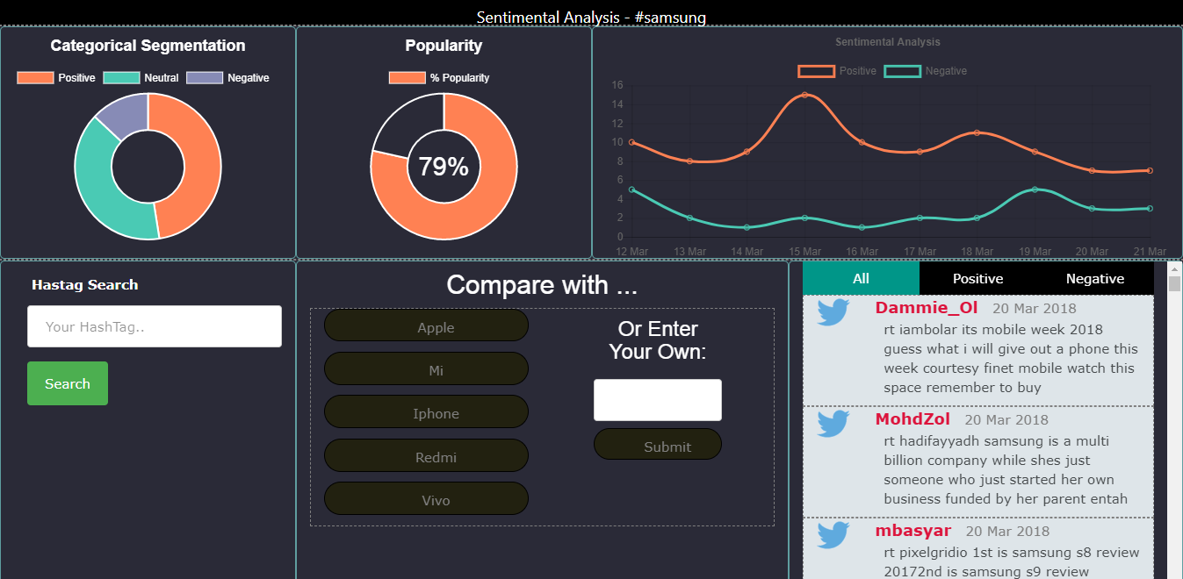
Home PAGE

Slide 4

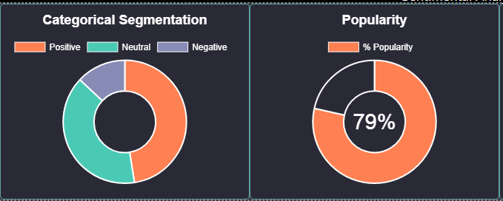
Smart Charts
1st Graph: Categorical Segmentation of Sentiments into positive, negative, and neutral classes.
2nd Graph: Popularity of entity entered by the user.

Slide 5
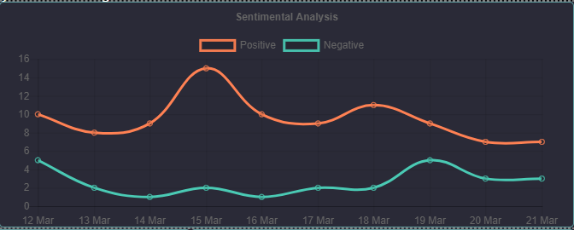
Timeline Graph
Showing number of positive and negative posts of users for past 10 days.

Slide 6

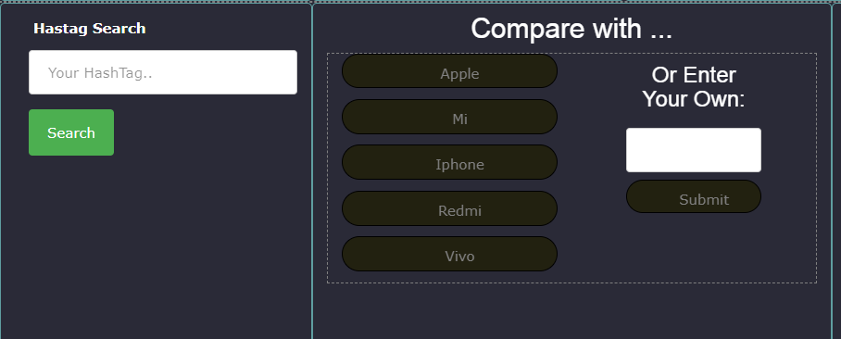
Simplicity
For
User
Smart Recommendation System based comparison

Slide 7
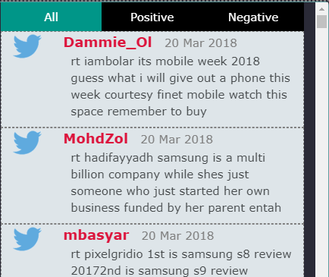
Get Real Time
Status
Classifying Posts into their respective categories – placate the implacable
Make better products, politicians, restaurants and more!

Slide 8
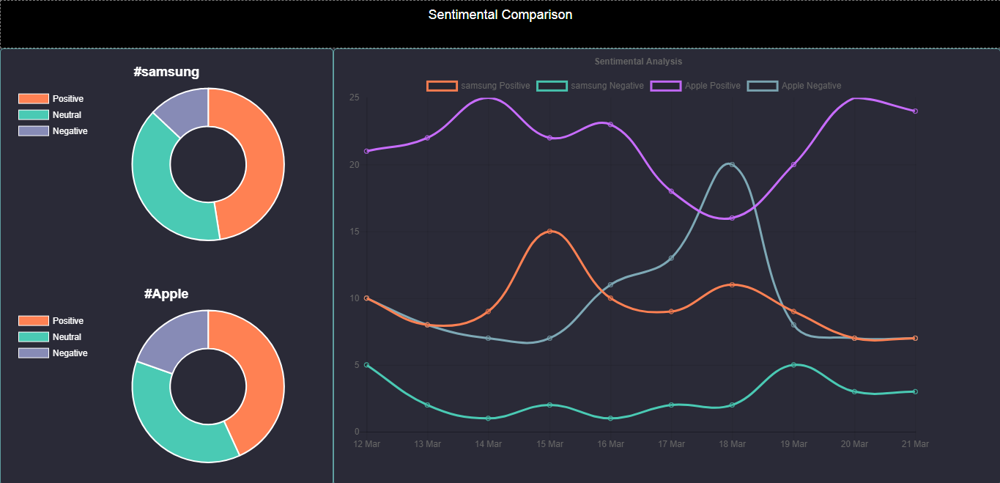
Comparison PAGE

Slide 9


